Slide 1
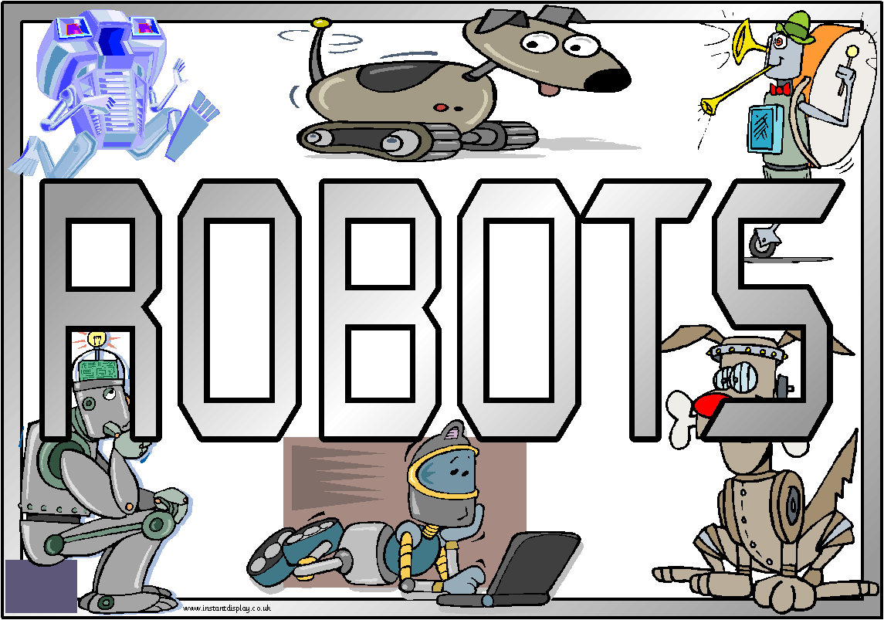

Slide 2
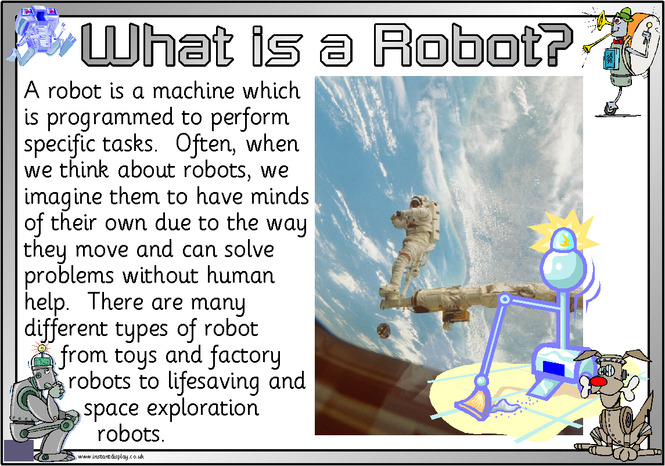


Slide 3
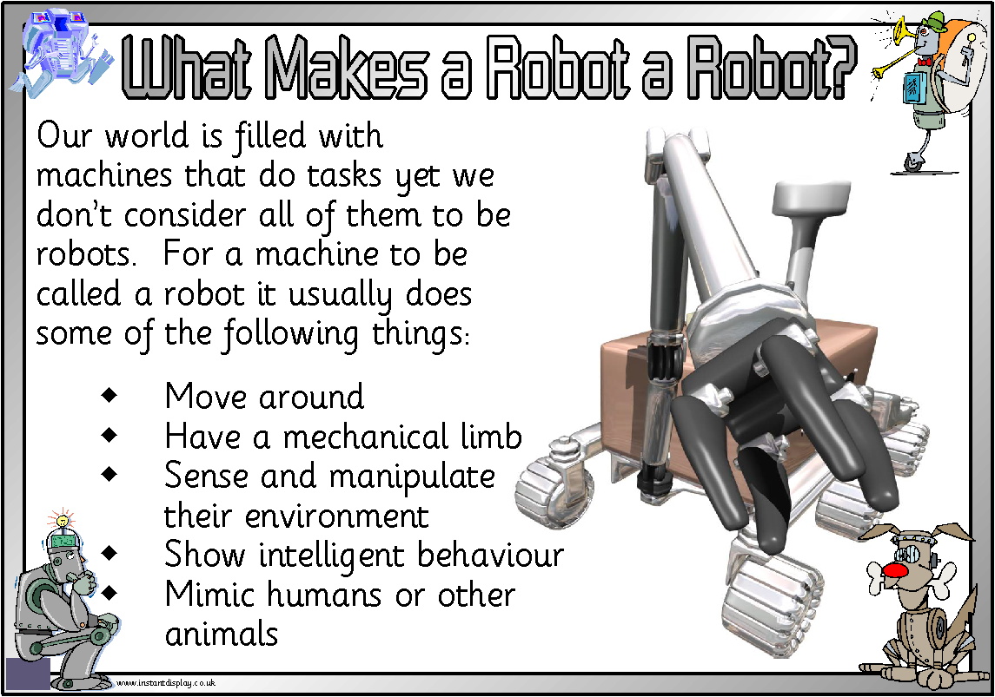

Slide 4
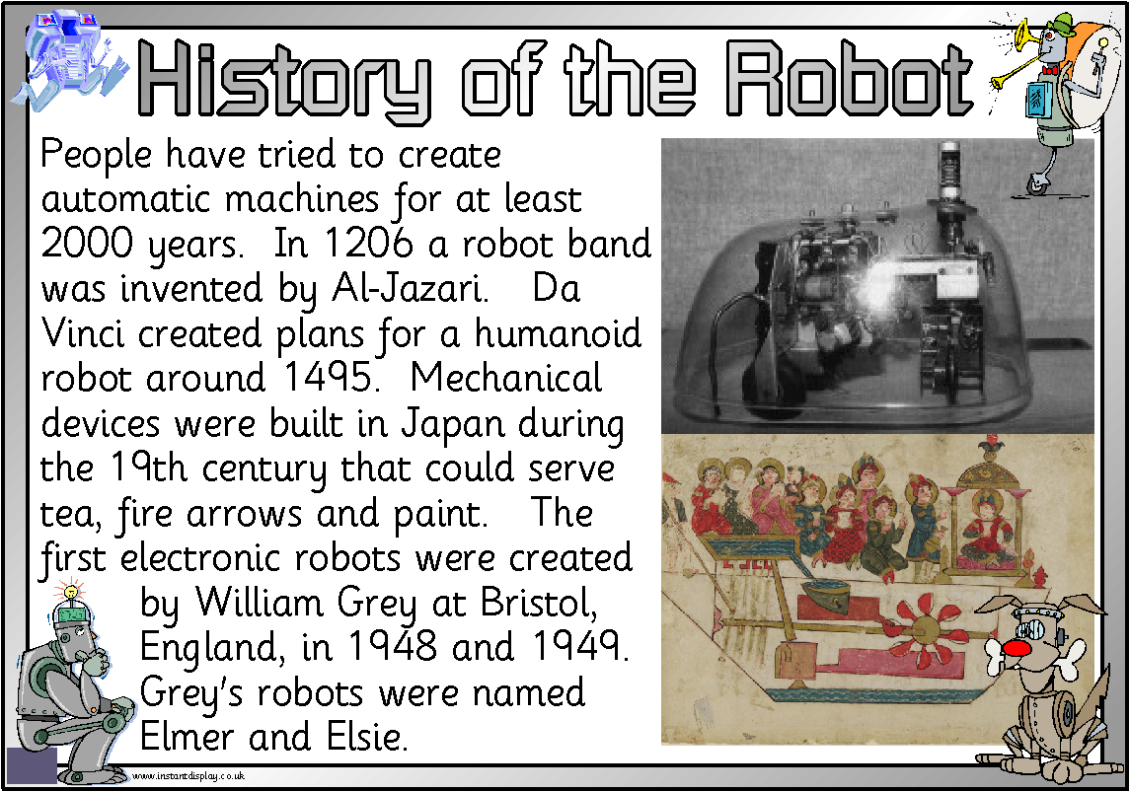

Slide 5
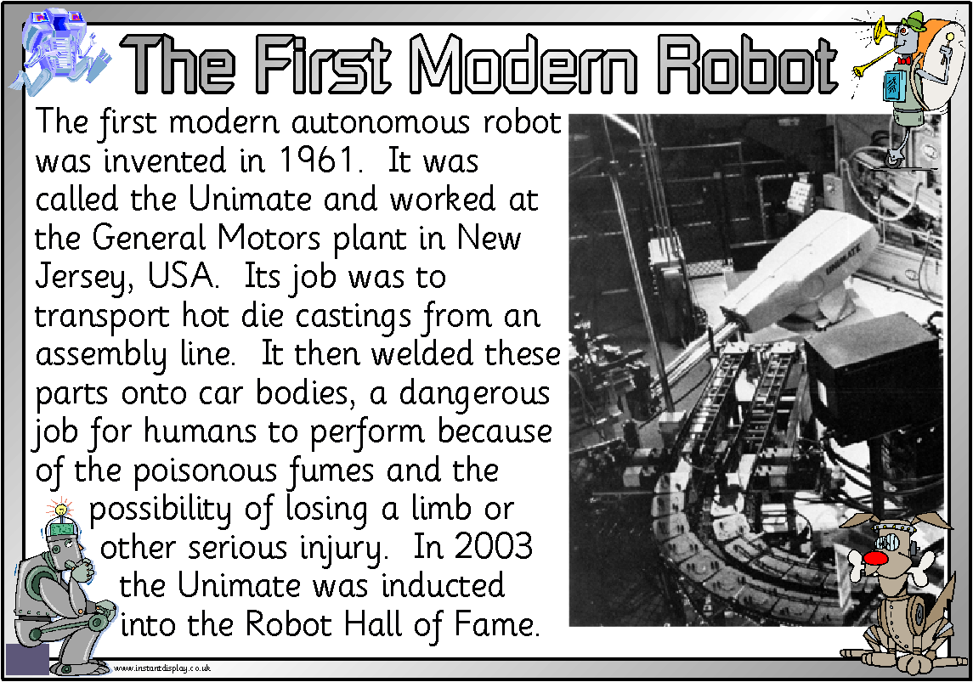

Slide 6
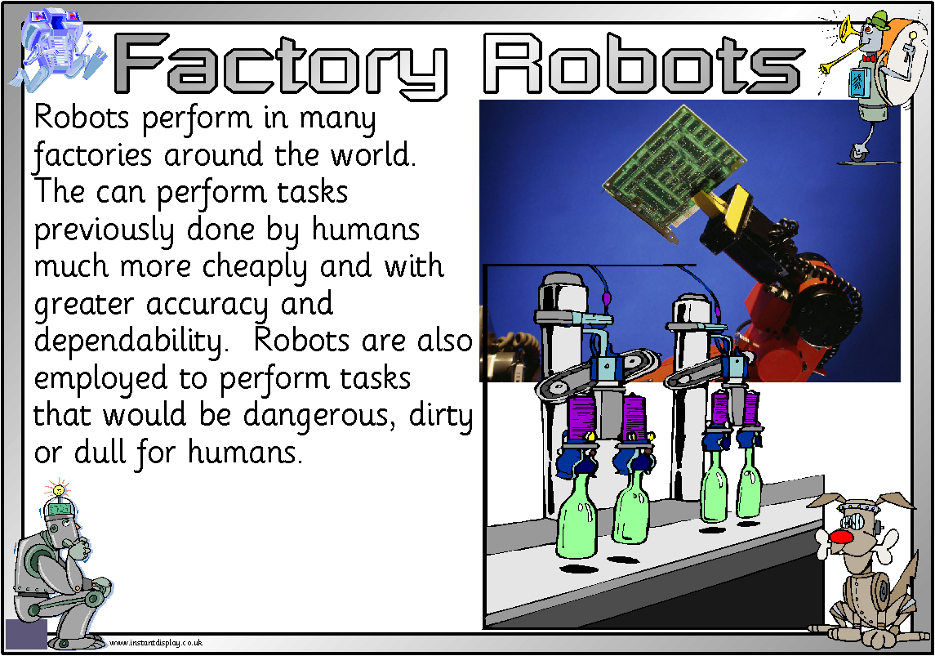

Slide 7
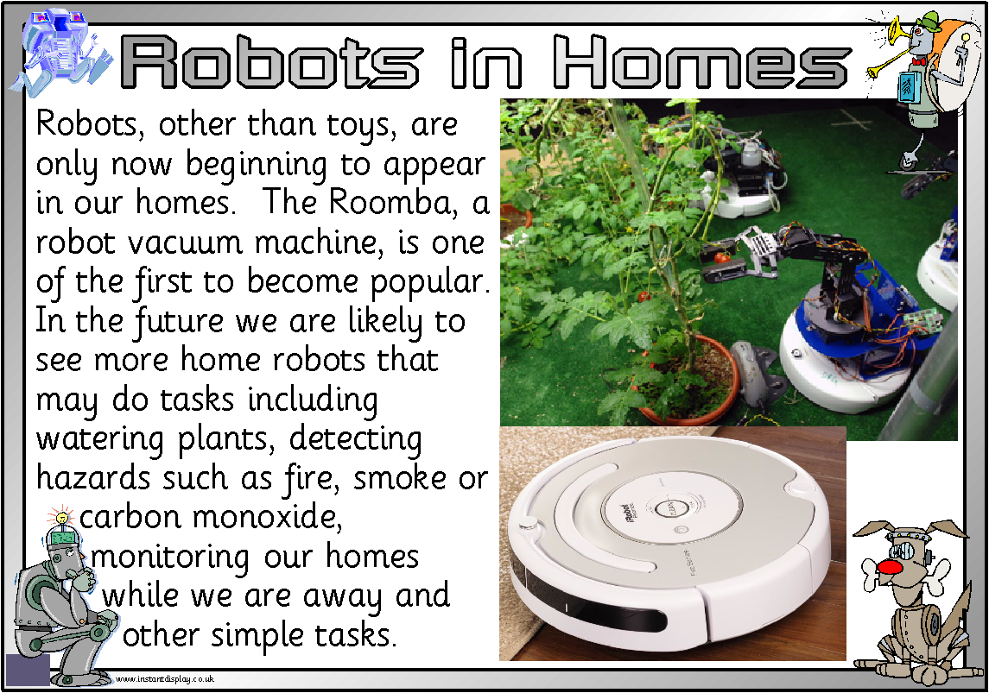

Slide 8
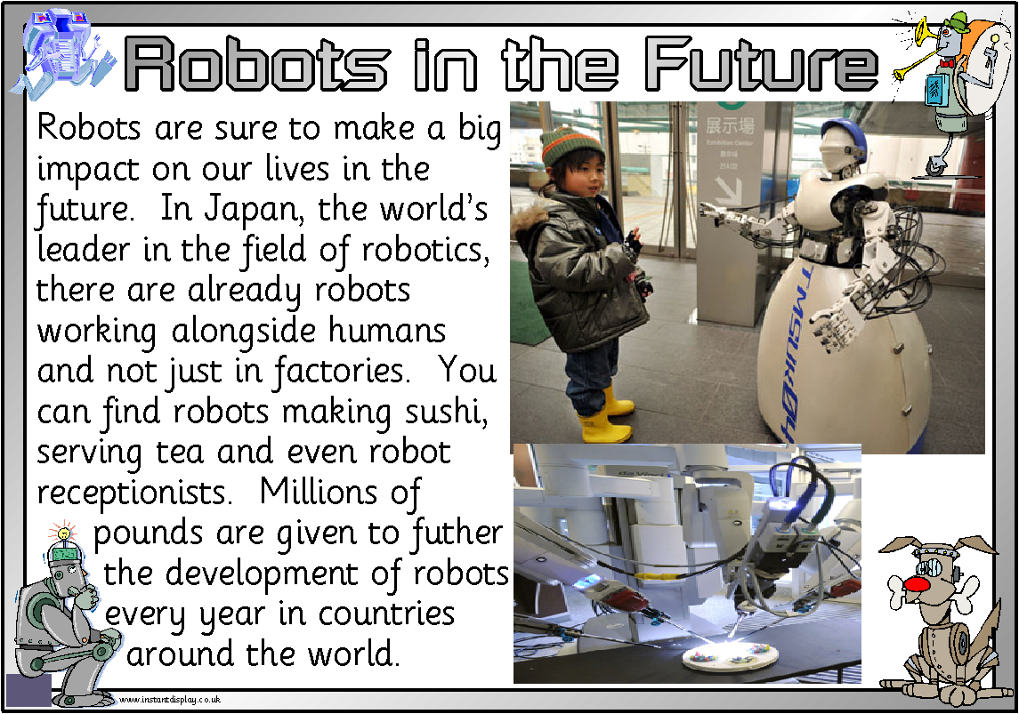

Slide 9
Robotics
Science/
Technology Project

Slide 10
The aim of our project...
The aim of the project is to give primary P6/P7 pupils a chance to work with the latest in small robot technology without it being hidden in a grey box. Much of modern technology is invisible and seems like magic when it works!! In fact, it is developed by many thousands of engineers throughout the world. We will hopefully see past the ‘magic’ and understand that there are many incredibly interesting careers for budding electronic engineers.

Slide 11
As an example, this video shows the electronic insides of an Apple Ipod.
http://www.youtube.com/watch?v=tX9K35MuO_8&feature=player_embedded

Slide 12
Each pupil team (normally 3 pupils) is issued with their own robot in a cardboard box. The robot comes in a number of bits and the first activity to build it and test it.
The Pupil Kit...

Slide 13
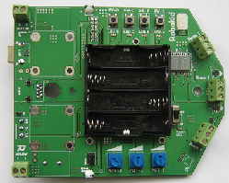
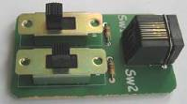
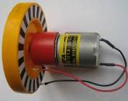

Item | Number | Description | Picture
Circuit board in special bag | 1 | Board holds all the electronics of your robot vehicle
Switch controller | 1 | Simple controller to steer robot
Motor with plastic wheel and encoder | 2 | Drive system for the robot
Plastic rivet | 9 | 8 used to fix the two motors to the circuit board 1 used to fix pen holder to the board | All rivets are the same size

Slide 14


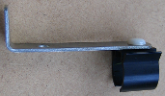
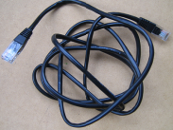

Dome nut | 1 | Provides a front “wheel” for the robot
Plastic screw | 1 | To fix dome nut to the circuit board
Pen holder bracket | 1 | Allows robot to carry a marker pen.
Controller cable | 1 | Connects switch controller to the robot
Screwdriver | 1 | To screw cables and components onto circuit board Also can be used to strip insulation from wires

Slide 15
Activity 1....
Our first activity will be next Thursday and you will build and test a small electronic robot vehicle in preparation for other activities. Today we will sort you into your groups.

